Slide 1
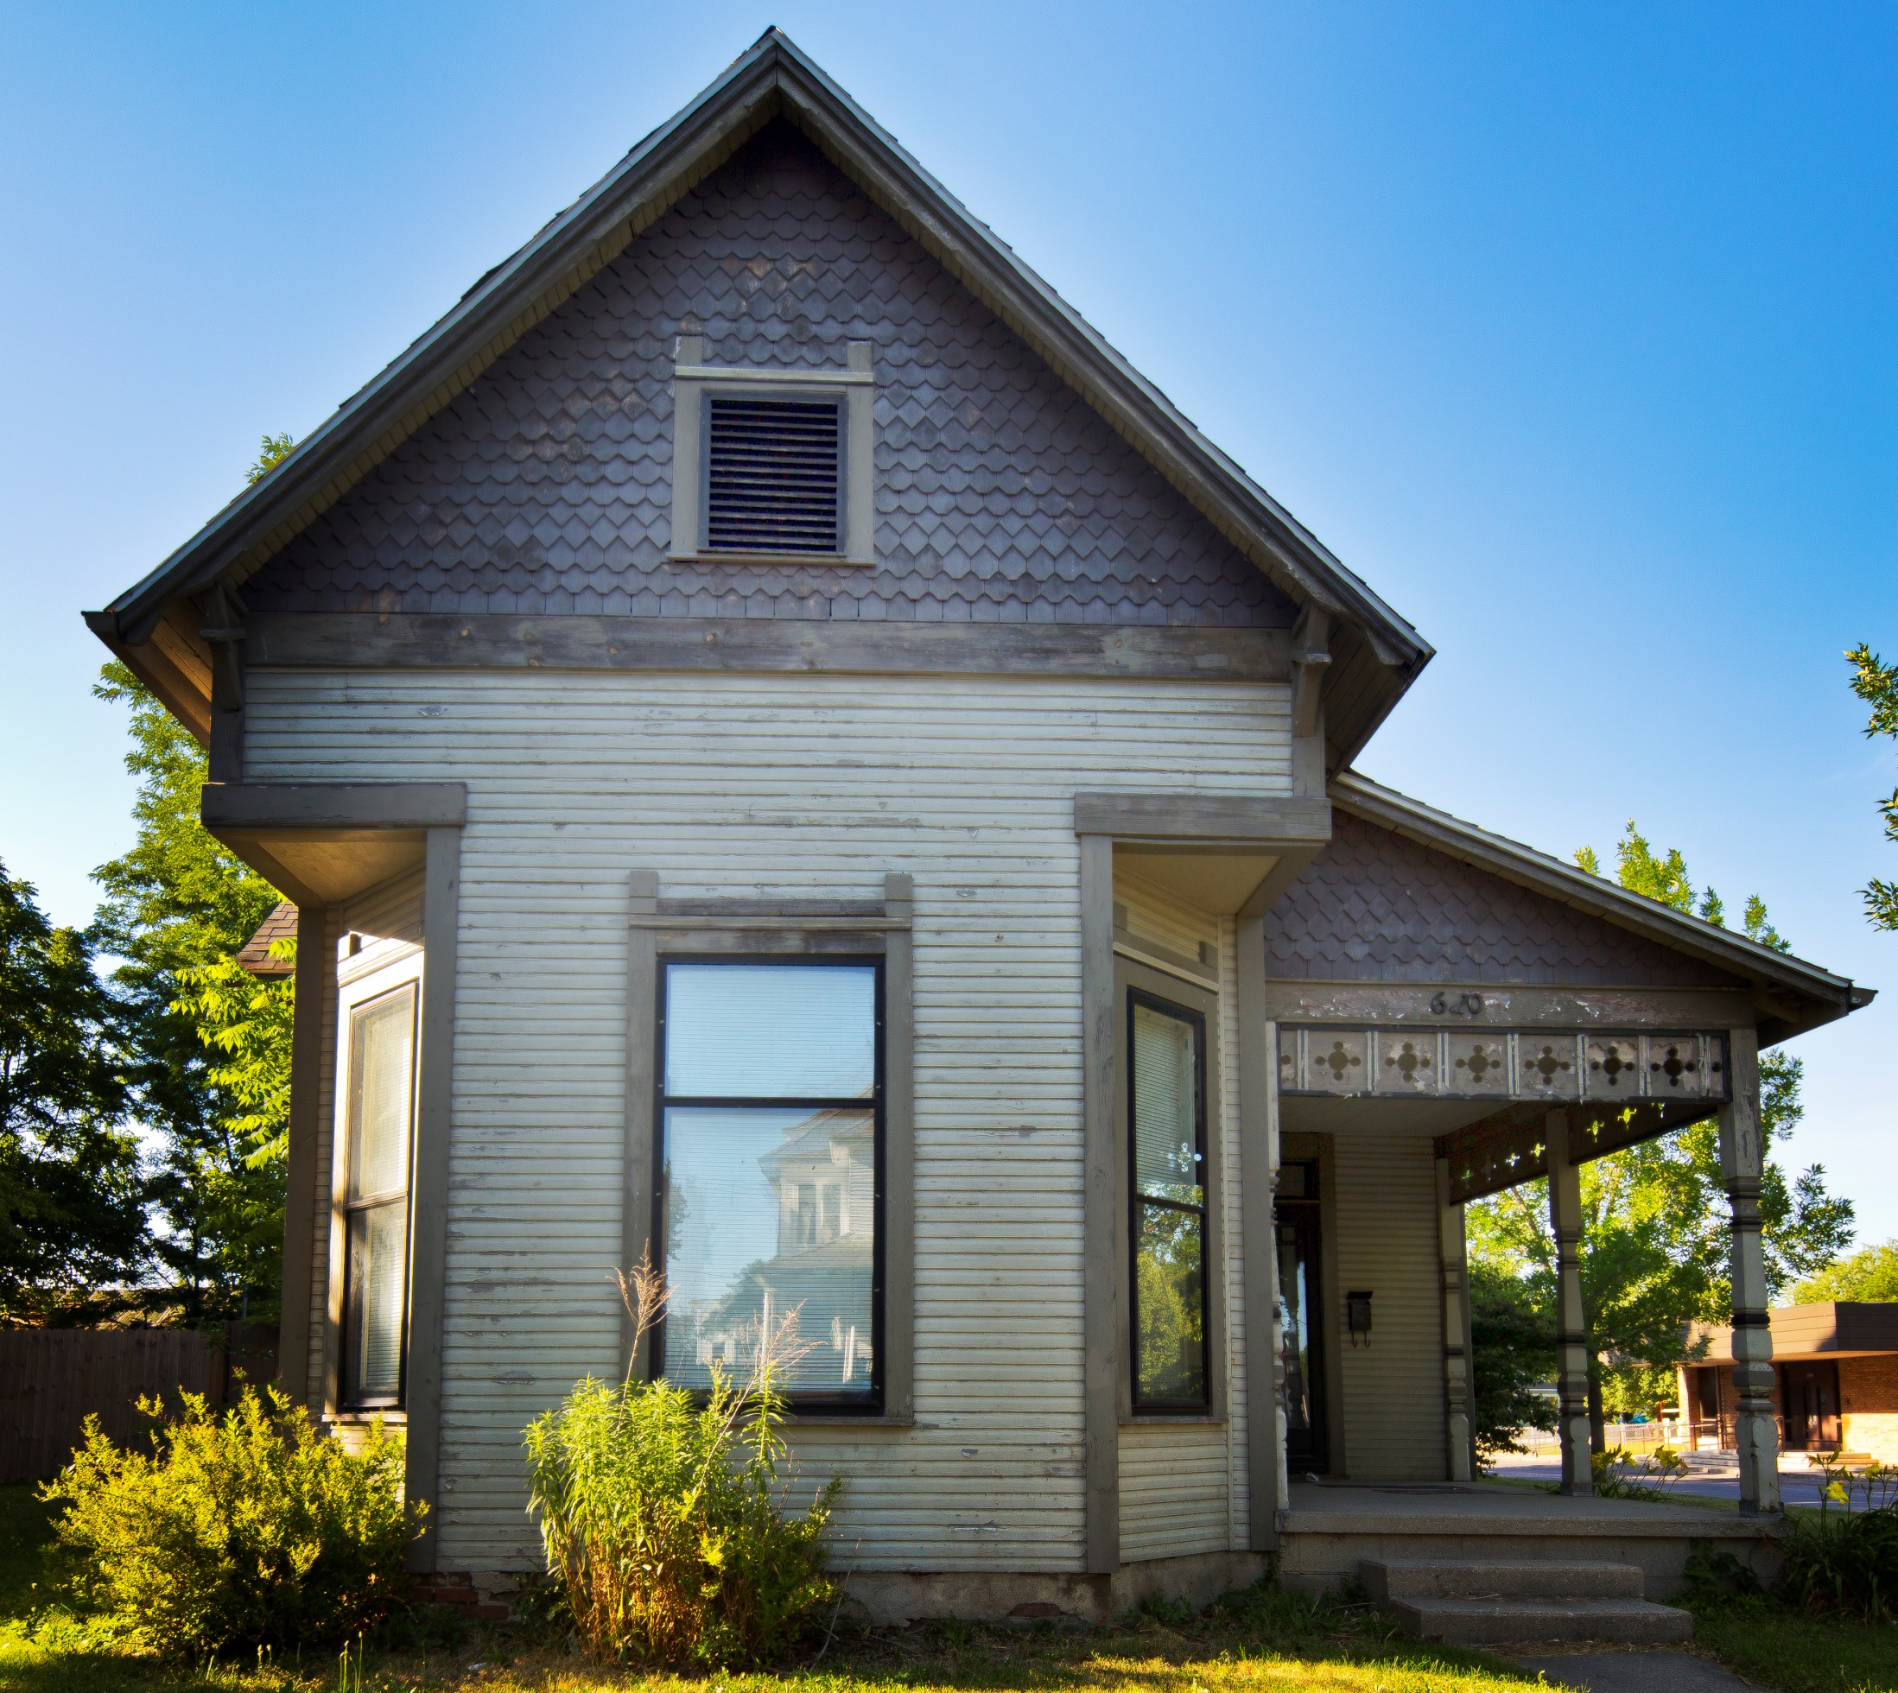
ScoutMuncie
A WAY FORWARD FOR DATA-DRIVEN NEIGHBORHOOD REVITALIZATION
Briana Grosicki & Brad King

Slide 2
Revitalization Efforts
Data Collection/Inventory: ScoutMuncie
Historic Preservation: Comprehensive Preservation Plan
Notes:
So, today I’m here to discuss a data collection and inventory project called ScoutMuncie led by the Historic Preservation Commission, along with our draft comprehensive preservation plan recently completed and how these initiatives are inter-related.

Slide 3
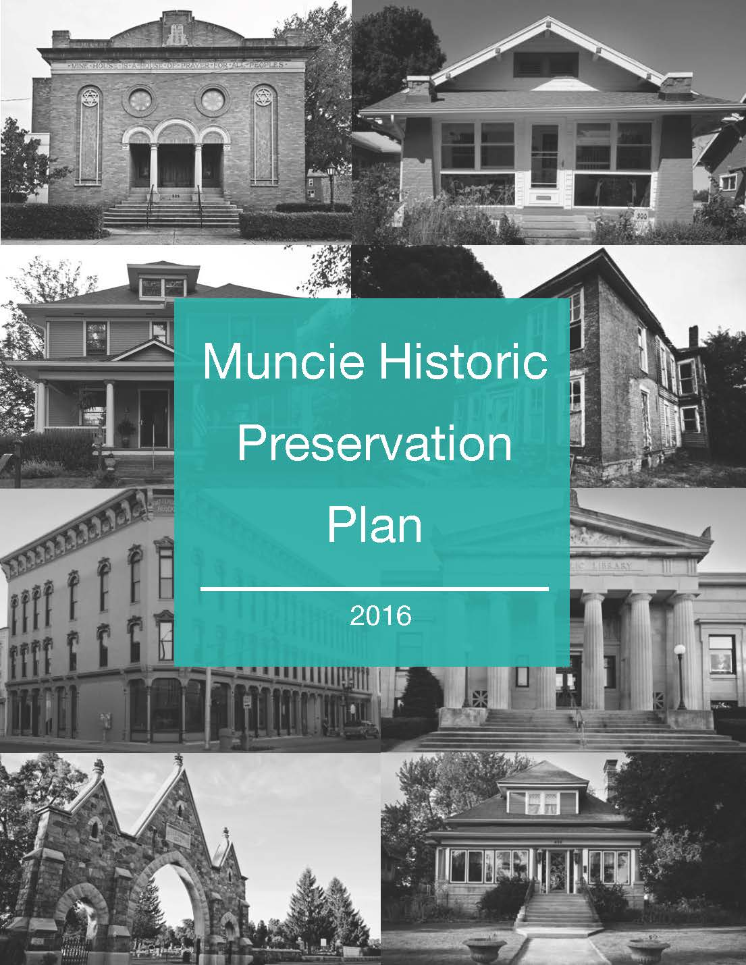
Muncie Preservation Plan
Initiative 1: Strengthen Pride and Image
Initiative 2: Advance Historic Preservation Education
Initiative 3: Create Attractive and Desirable Places
Initiative 4: Foster Collaboration
Initiative 5: Empower and Expand MHPRC
Initiative 6: Manage Community Resources
Notes:
Here are the six initiatives in the HP Plan, I’ll go through them briefly to explain a few action steps in each initiative.

Slide 4
Information is key
DATA

Slide 5
Information is key
DATA
DECISIONS

Slide 6
Data Drive Detroit
Notes:
One of the things that drives me is the principle of equitable redevelopment, that every neighborhood has a bright future that does not include blight. I stole this photo from a group called Data Driven Detroit – I’m not trying to compare Muncie to Detroit but this message of “every neighborhood has a future that does not include blight” rings true to Muncie.

Slide 7
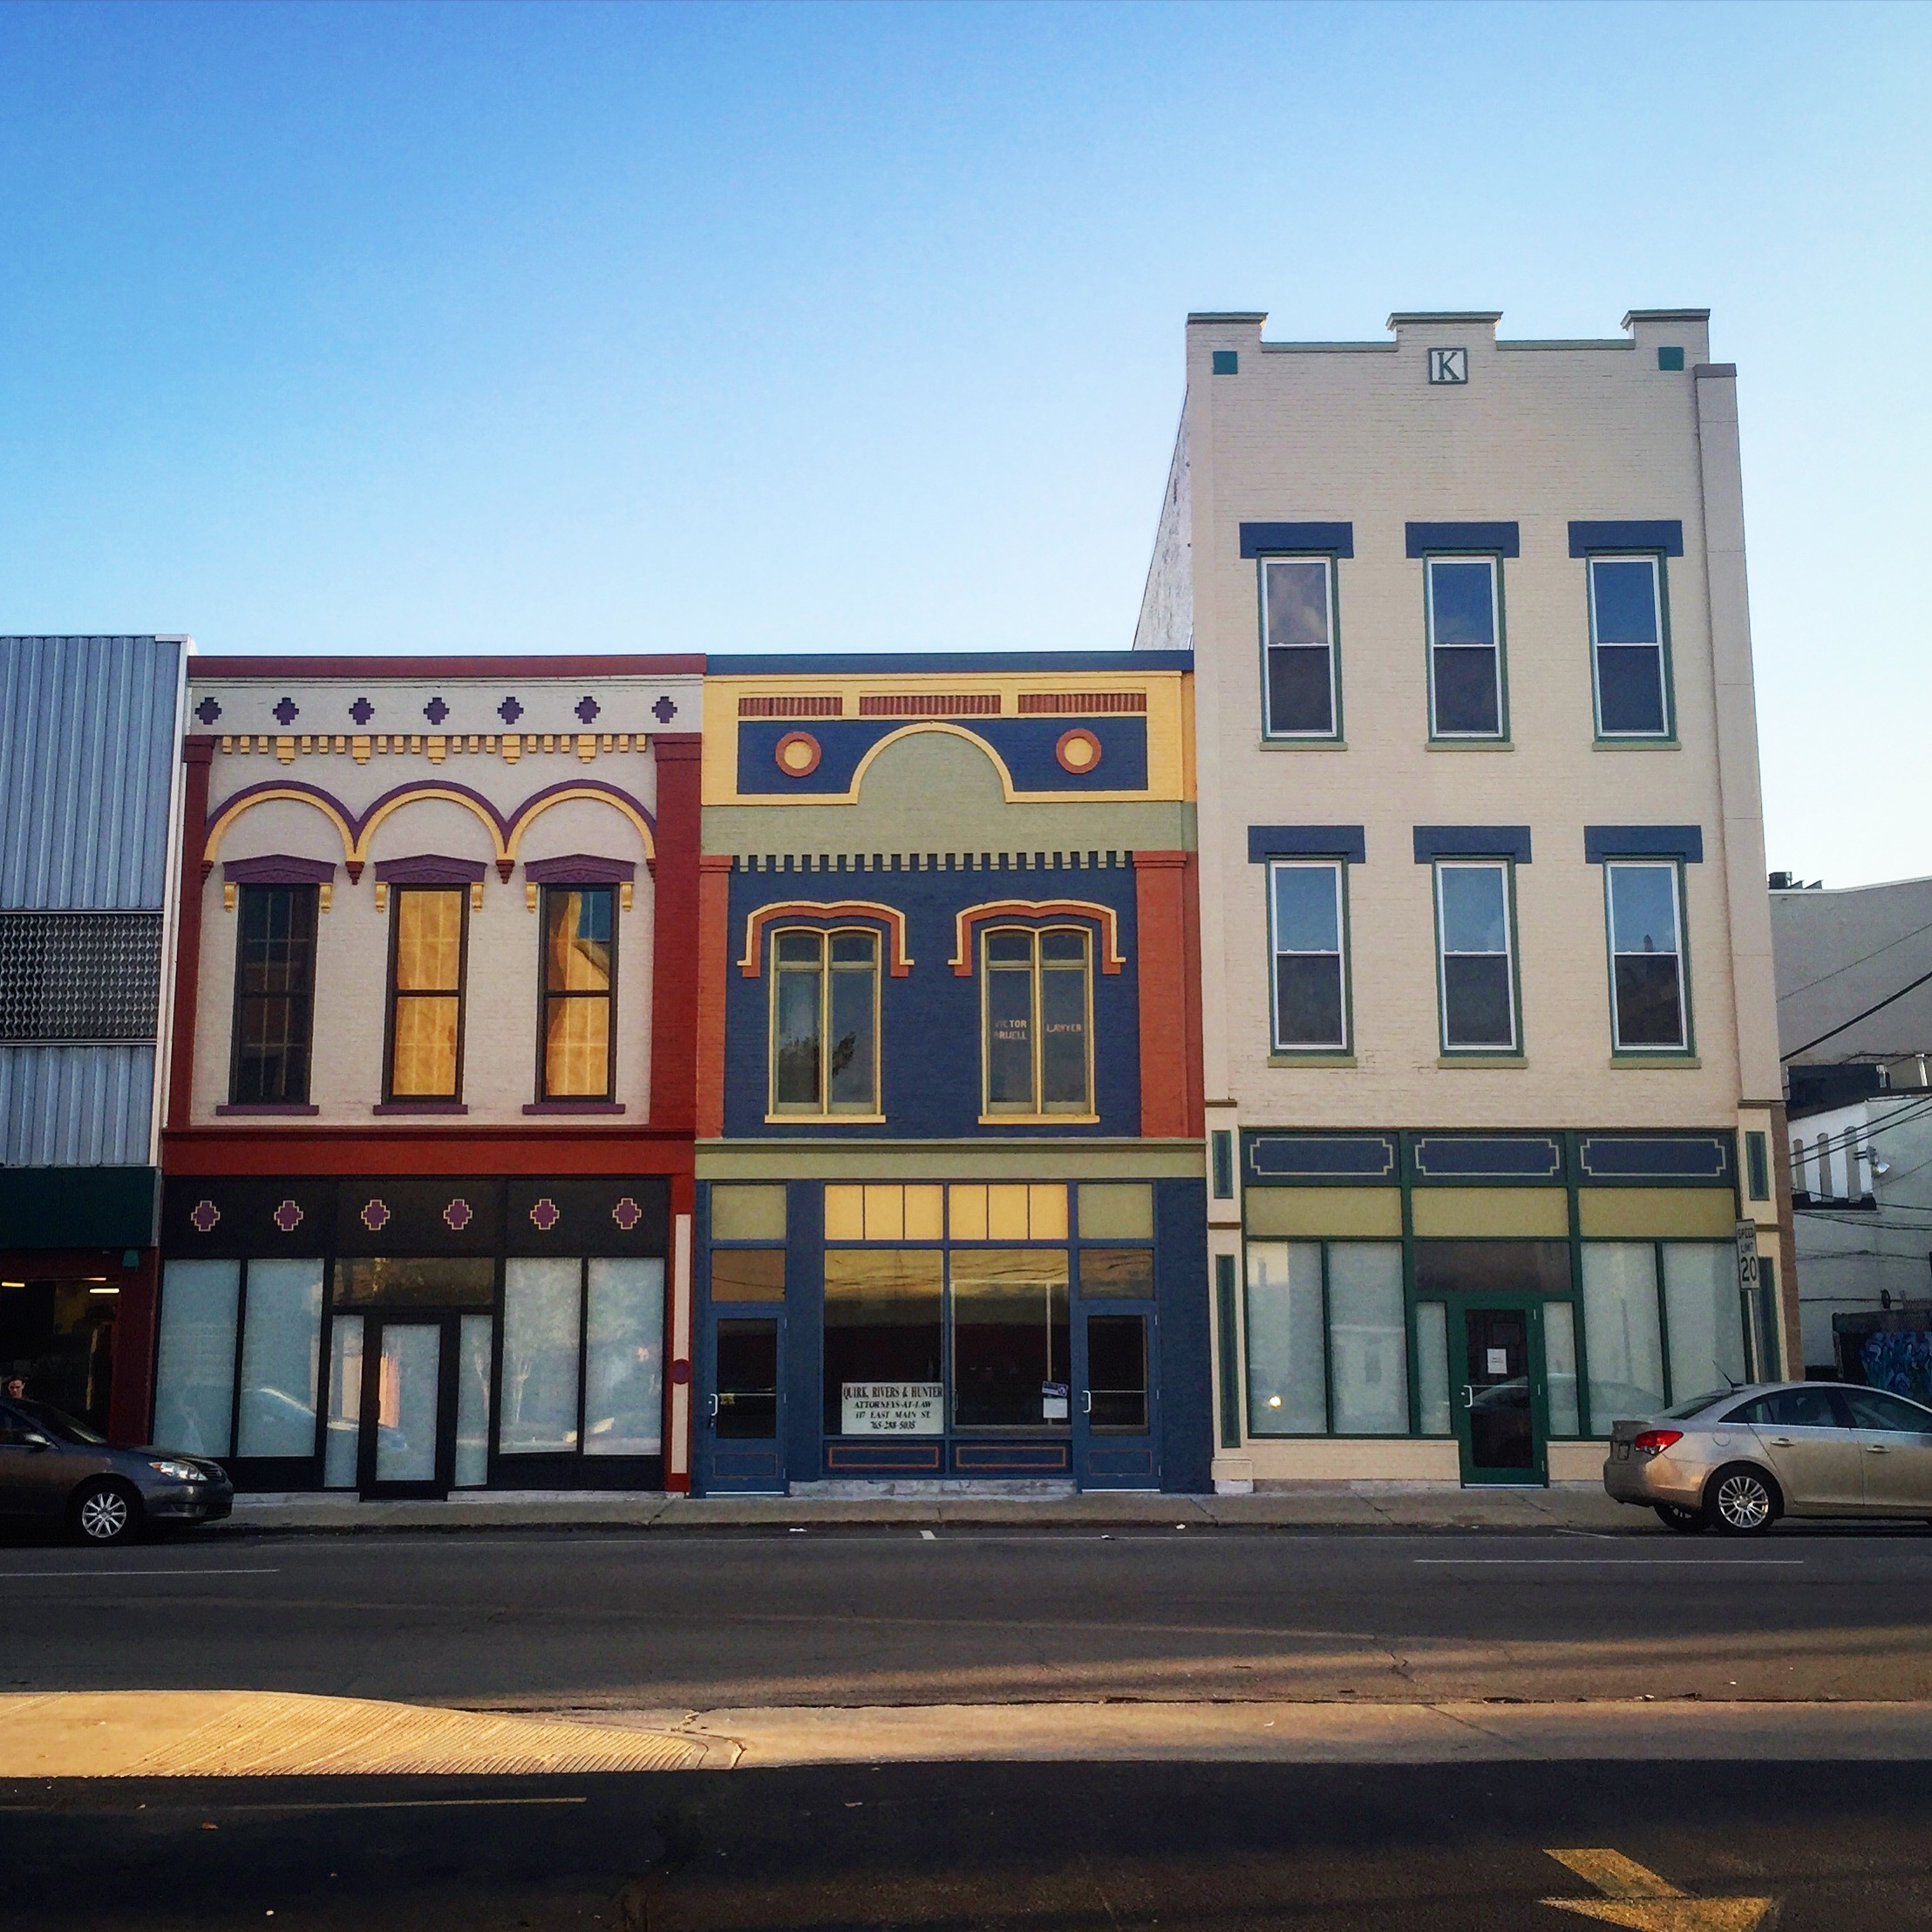
What is muncie doing?

Slide 8
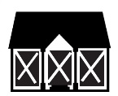
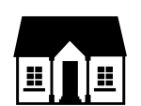
Information is key
Population (US Census)
Vacant Housing Units
Number of Housing Units
76,460
70,087
5,023
67,468
32,413
4,236
31,958
2,892
30,212
1980
2000
2015
2000
2010
2015
2000
2010
2015
4%
74%
7%
increase since 2000
increase since 2000
increase since 2000

Slide 9
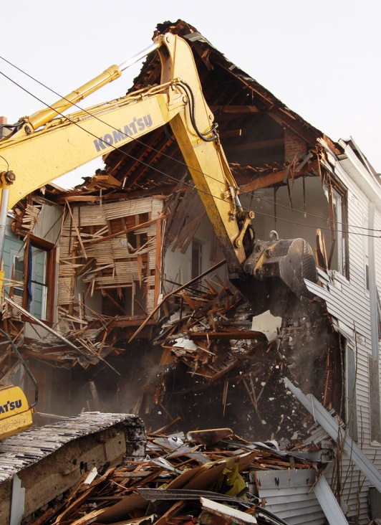
Limited resources
~25 structures/year
$220,000
CDBG funds
70 years

Slide 10
76% of all structures over 50 years old

Slide 11
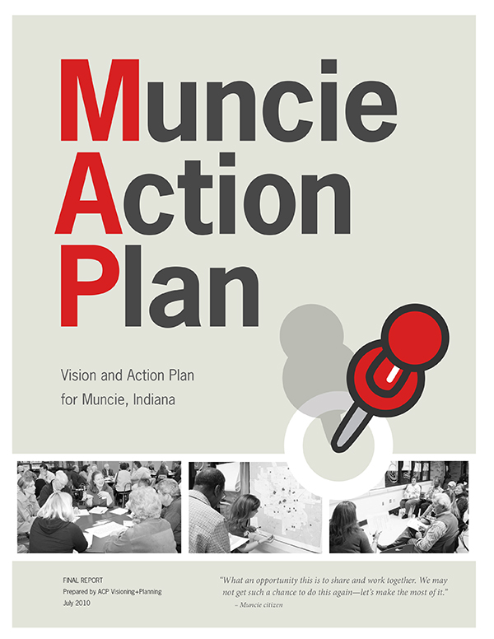
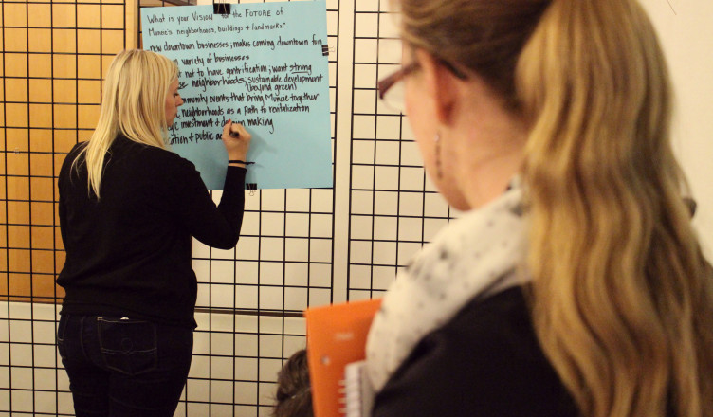
Public Input for HP Plan
Notes:
This document was created because its part of our ordinance to have a plan with surveys and maps. Our last plan is from 2007 and has one action step to create historic districts – we as a commission felt that having one goal was not productive and that one goal that was established for us in 2007 should not be our main focus. A Ball State graduate studio in historic preservation helped create this plan for us by participating in ScoutMuncie, researching best practices, hosting several community meetings and seeking public input. The plan aligns with the existing goals already established for the community by the Muncie action plan. So we are simply saying, here is how historic preservation contributes to these larger community goals and here are some ways the historic commission and partners can accomplish it.

Slide 12
Impetus for Survey
Only 4% recognized as historic from 1985 survey
No accurate data on blight

Slide 13
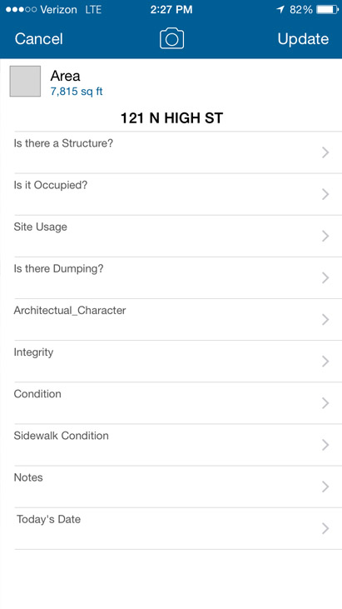
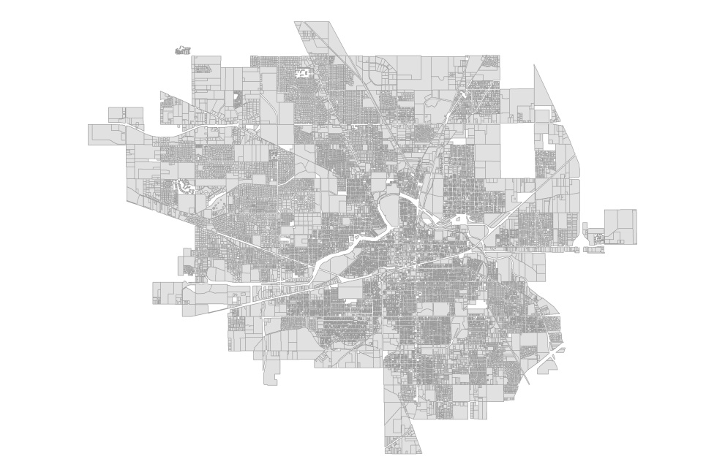
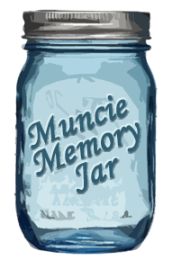
ScoutMuncie – A Citywide Survey
Survey all 30,000 parcels in the city for accurate property conditions

Slide 14
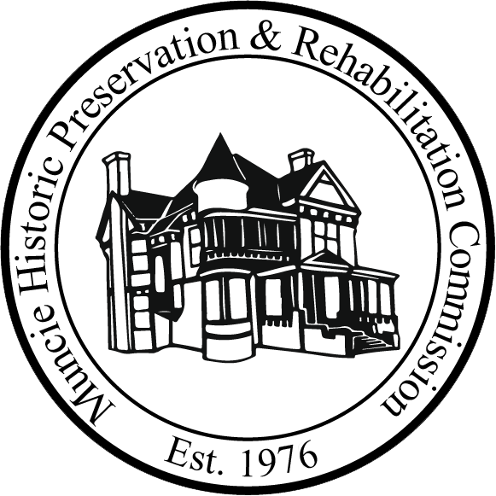
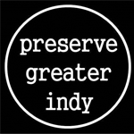
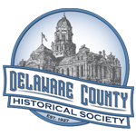
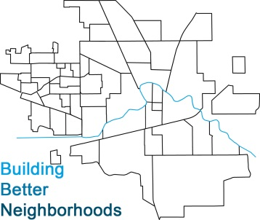
Collaboration

Slide 15
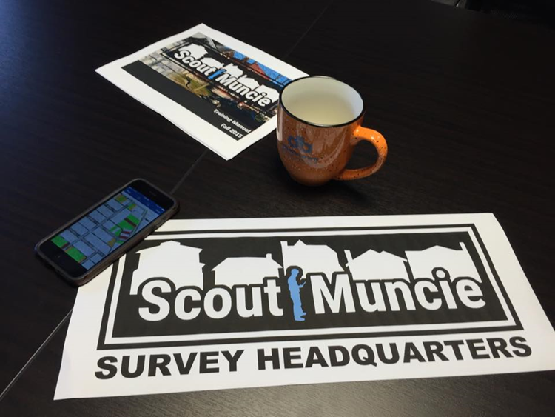

Slide 16
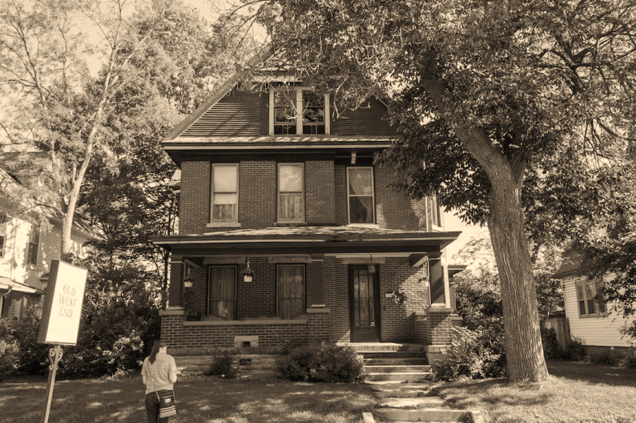
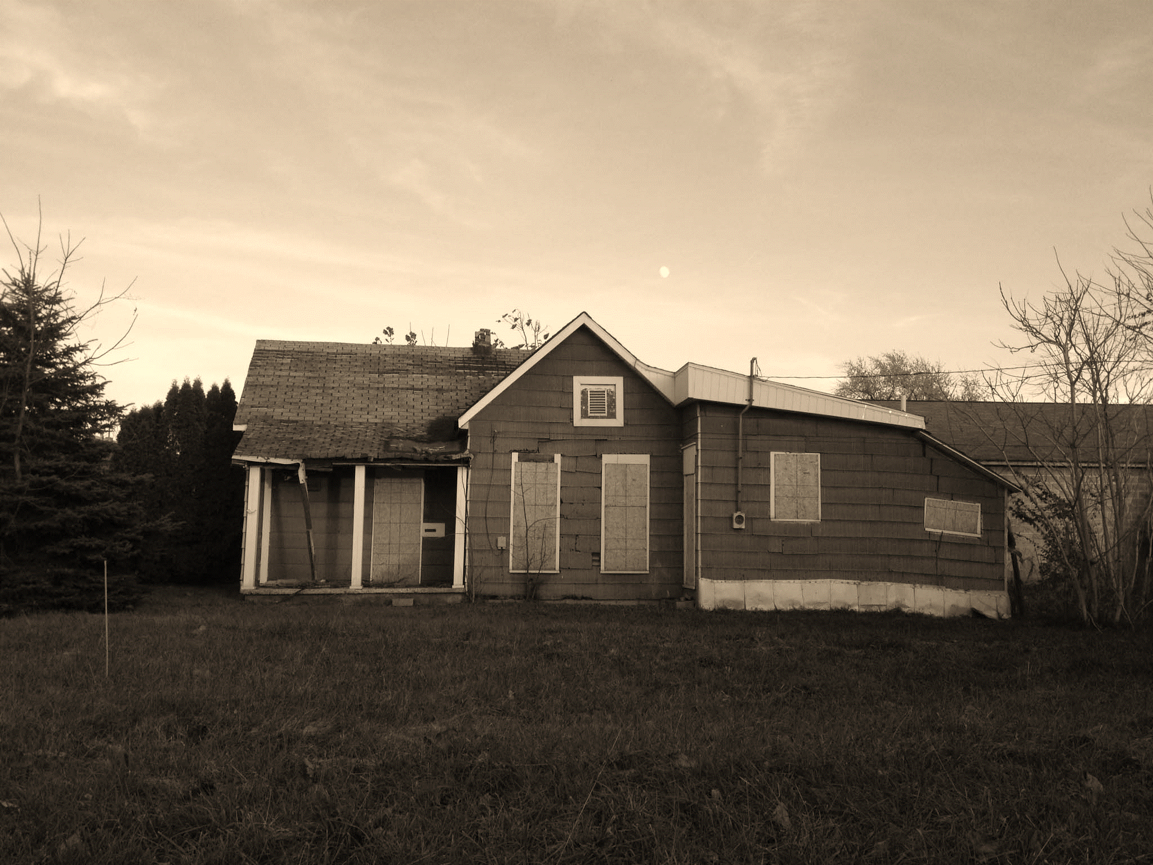
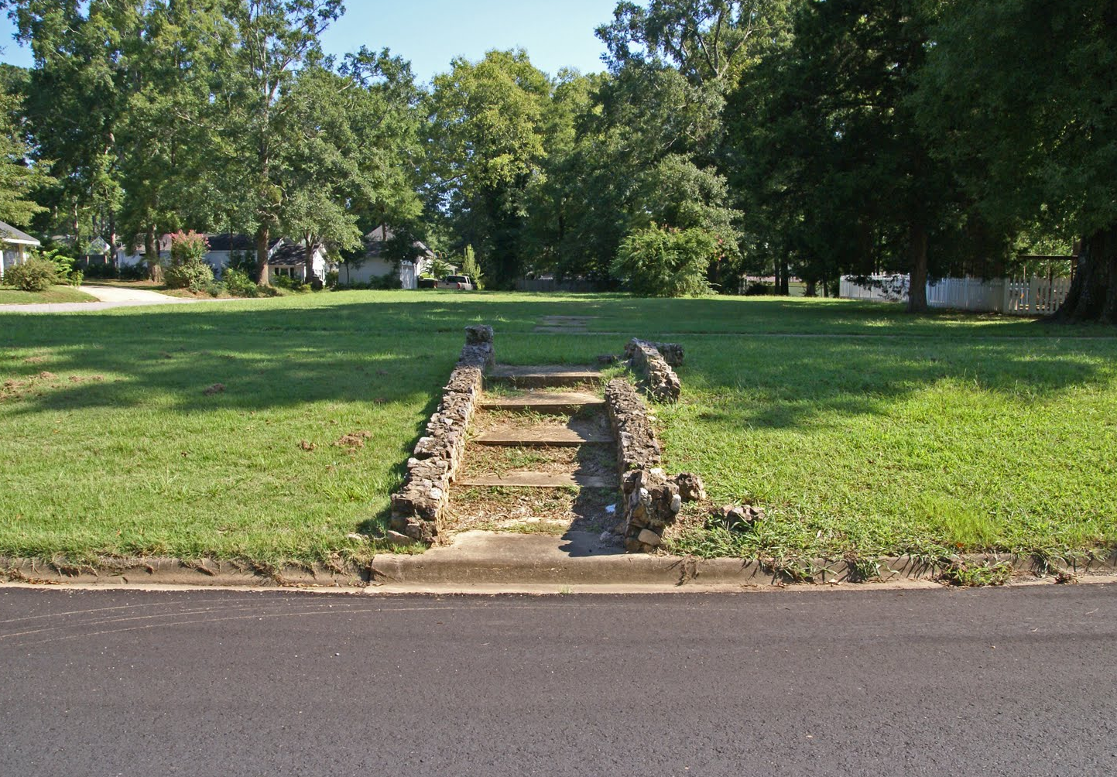
RESULTS
Notes:
Can you make the top right and bottom left pics sepia?

Slide 18
Vacancy effects all of Muncie
62%

Slide 20
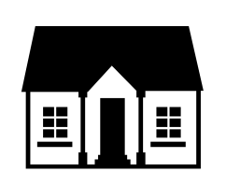
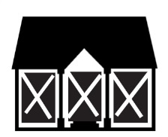
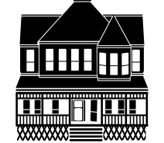
Zone 1: Southside
4,488 properties
84.4%
include a structure
5.4%
vacant buildings
2.7%
vacant lots
0.2%
high or landmark architectural character buildings

Slide 21
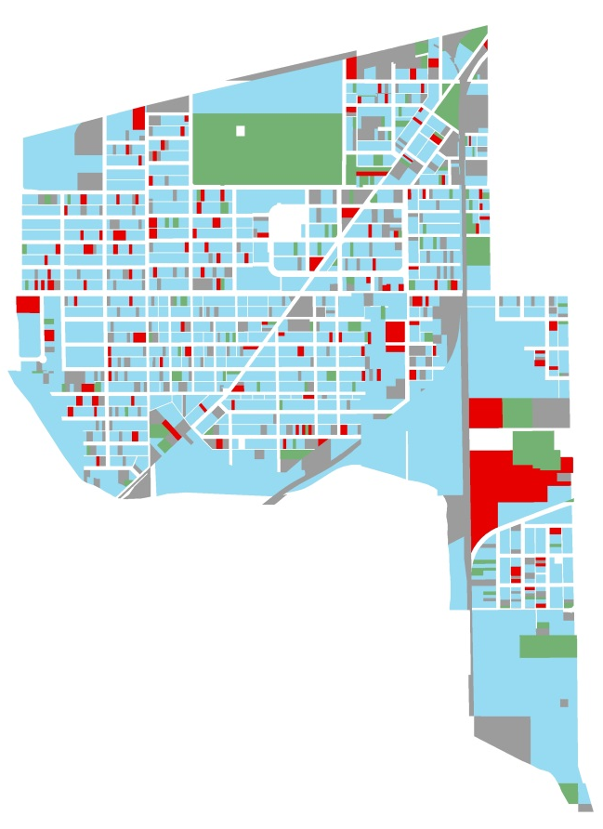
Zone 2: Thomas Park-Avondale
2,329 properties
81.6%
include a structure
6.4%
vacant buildings
5.2%
vacant lots
0.7%
high or landmark architectural character

Slide 22
Zone 3: Industry
1,408 properties
67.1%
include a structure
9.7%
vacant buildings
17.2%
vacant lots
2.3%
high or landmark architectural character

Slide 23
Zone 4: Old West End
860 properties
72.4%
include a structure
6.7%
vacant buildings
12.3%
vacant lots
15.2%
high or landmark architectural character

Slide 24
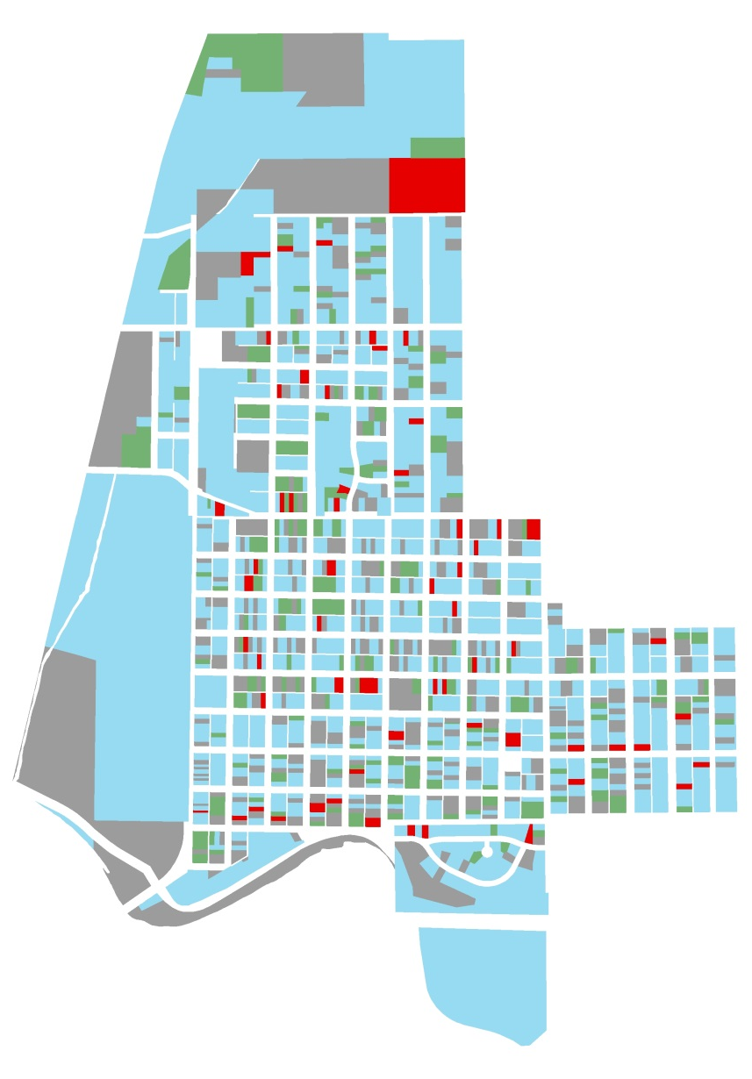
Zone 5: Whitely
1,585 properties
73.8%
include a structure
4.1%
vacant buildings
16.7%
vacant lots
0.3%
high or landmark architectural character

Slide 25
Zone 6: Cowing Park
573 properties
86.4%
include a structure
1.9%
vacant buildings
4.5%
vacant lots
1.6%
high or landmark architectural character

Slide 26
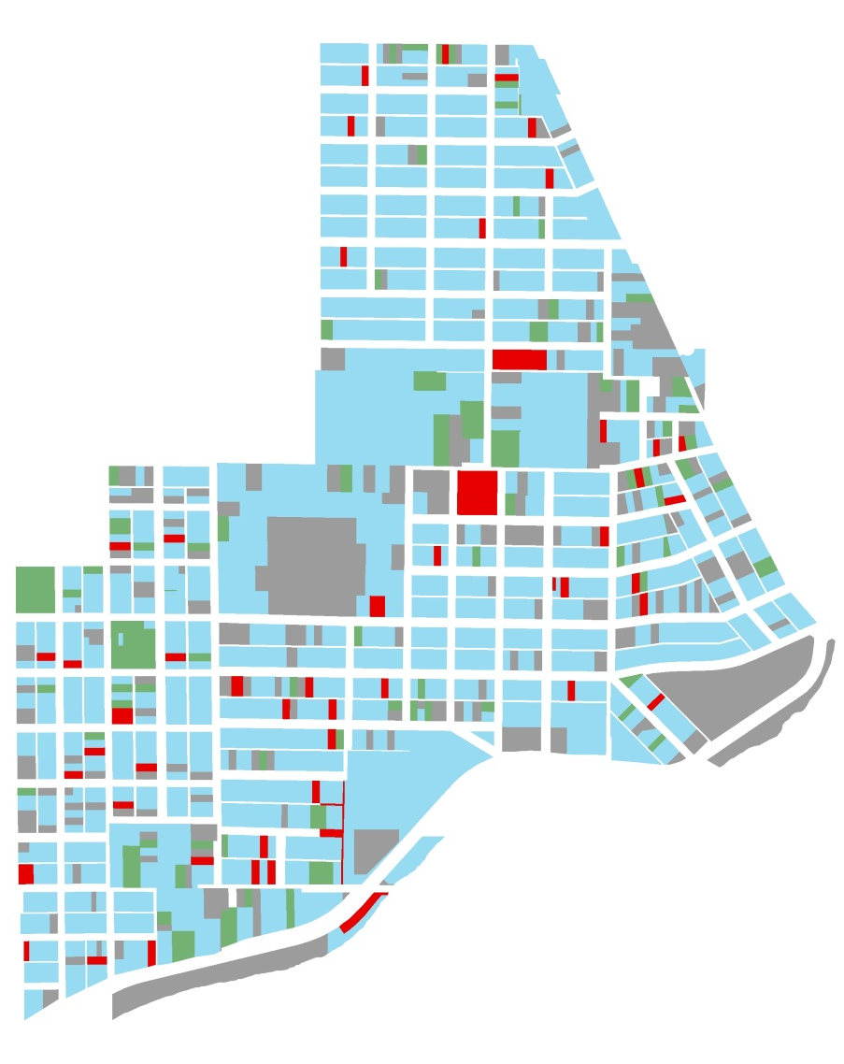
Zone 7: Riverside/Normal City
1,449 properties
82.7%
include a structure
3.5%
vacant buildings
6.1%
vacant lots
14.8%
high or landmark architectural character

Slide 27
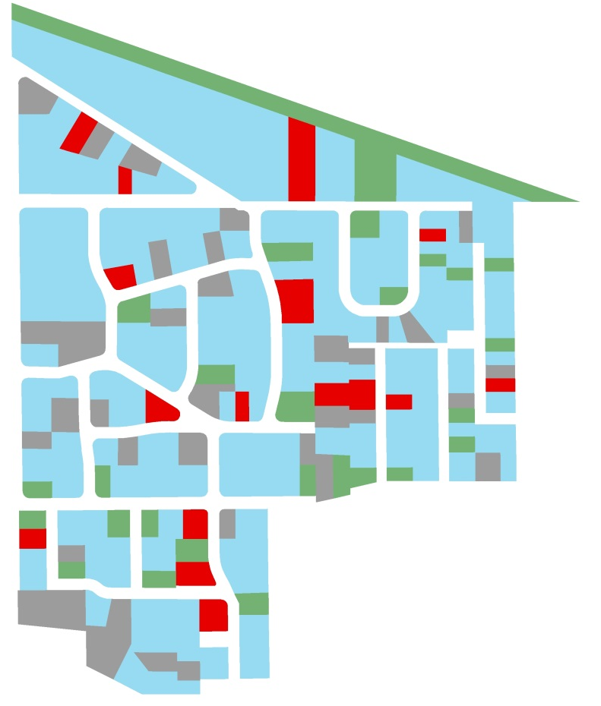
Zone 8: Ludingwood
293 properties
78.2%
include a structure
6.5%
vacant buildings
9.6%
vacant lots
2.2%
high or landmark architectural character

Slide 28
Neighborhood Comparisons
We need different reinvestment strategies for different neighborhoods
 | % include a structure | %Vacant structures | %Vacant lots | %High or Landmark Character Buildings
Southside | 84.4% | 5.4% | 2.7% | 0.2%
Thomas Park | 81.6% | 6.4% | 5.2% | 0.7%
Industry | 67.1% | 9.7% | 17.2% | 2.3%
Old West End | 72.4% | 6.7% | 12.3% | 15.2%
Whitely | 73.8% | 4.1% | 16.7% | 0.3%
Cowing Park | 86.4% | 1.9% | 4.5% | 1.6%
Riverside | 82.7% | 3.5% | 6.1% | 14.8%
Ludingwood | 78.2% | 6.5% | 9.6% | 2.2%
Notes:
Can you get rid of that white background on the vacant structure art?

Slide 29
A different view of vacancy

Slide 30
The vacancy vortex
Vacancy lowers property values
Properties with little to no value
No financing or insurance available for blighted properties
Lower tax values strain city budget
Scarce resources to perform same city services
Public safety concerns with vacancy

Slide 31
Getting out of The vacancy vortex
Strategic investment
Sustainable and fiscally responsible development
Incremental development
Public-private partnerships
Using people talent when money isn’t available

Slide 32
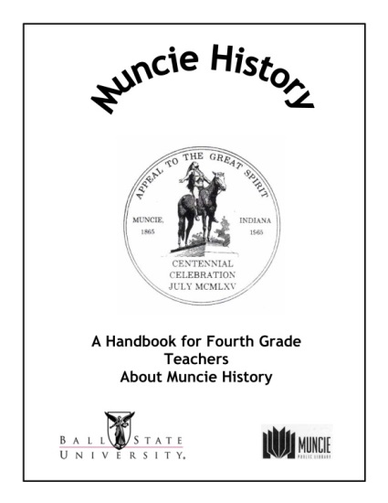
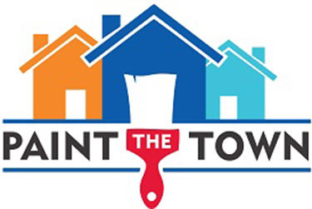
Action Steps
Initiative 1: Strengthen Pride and Image
Initiative 2: Advance Historic Preservation Education
Initiative 3: Create Attractive and Desirable Places
Initiative 4: Foster Collaboration
Initiative 5: Empower and Expand MHPRC
Initiative 6: Manage Community Resources
Heartbombing Campaign
Neighborhood branding and marketing
Publicize historic resources
Paint properties in need
Notes:
For strengthen pride and image, the plan suggests things like a heartbombing campaign, which is when a bunch of people get together make hearts and stand in front of a building they value whose future is uncertain and blast this on social media. Another pride and image step is to help neighborhood associations create neighborhood branding and marketing something similar to the downtown muncie campaign. For advancing historic preservation education, it could be things like a realtor education seminar or getting a local history segment incorporated into the public school curriculum or events. For create attractive and desireable places, it could be things like Cincinnati’s Paint the Town where a nonprofit hosts a yearly event to paint 40 homes of folks in need.

Slide 33
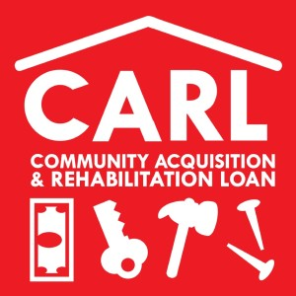
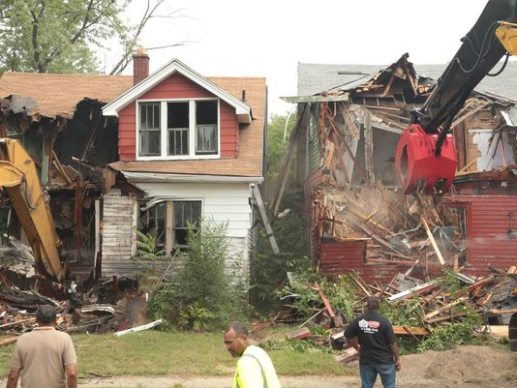
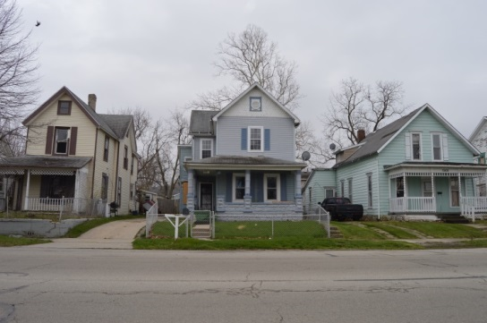
Action Steps
Collaborative Workshops
Initiative 1: Strengthen Pride and Image
Initiative 2: Advance Historic Preservation Education
Initiative 3: Create Attractive and Desirable Places
Initiative 4: Foster Collaboration
Initiative 5: Empower and Expand MHPRC
Initiative 6: Manage Community Resources
Partner with banks for alternative homeownership loans
Demolition review
Establish conservation districts
Notes:
For foster collaboration, the plan includes things like hosting collaboration workshops with Ball State or Ivy Tech to get students involved in the community build stays like the City of Charleston SC and the American College of Building Arts. Or partner with local banks to provide alternative homeownership loan products like Pittsburgh’s Community Acquisition and Rehabilitation Loan program. For empower and expand the historic commission, the plan suggests things like a demolition review on all structures over 50 years old. This wouldn’t be to stop all demos, but it would give a chance to give us a heads up when something is coming down to potentially find a new solution but more the likely just give us time to go out and photograph and document the structure. The plan also suggests we give regular update to city council about our activities. Lastly, managing community resources, diversifying our local landmark program and exploring the potential of conservation districts as well as historic districts is suggested.

Slide 34
What the Plan Does Do:
What the Plan Does NOT Do:
Lays a roadmap for action steps for the MHPRC beyond just districting
Publically recognizes Muncie’s historic assets as valuable
Recognizes historic preservation as an economic development focus in Muncie
Suggests partnerships for revitalization goals
Outlines potential policy changes for the City of Muncie pertaining to historic buildings
Aims to be transparent with the public about the goals of the MHPRC
Designate landmarks or historic districts or restrict property owners – designating landmarks or districts can only be accomplished when 51% of the property owners petition City Council to become a district via an ordinance.
Is a general guide but does not have full historic record of every building, much more research is necessary such as level of integrity
The plan has action steps but not specific projects

Slide 35
Information is key: How you can help
Let the Government Know there is an issue!
Get involved!
E-Gov
Pothole Twitter @munciepotholes
Facebook
Nextdoor
Visit scoutmuncie.wordpress.com
Use the data
Share the information
Make change in your neighborhood!

Slide 36
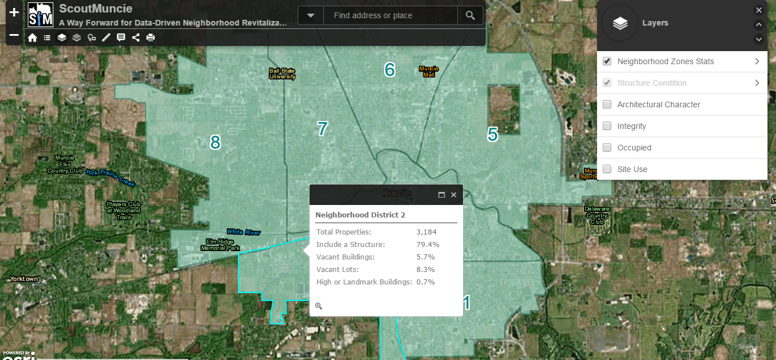
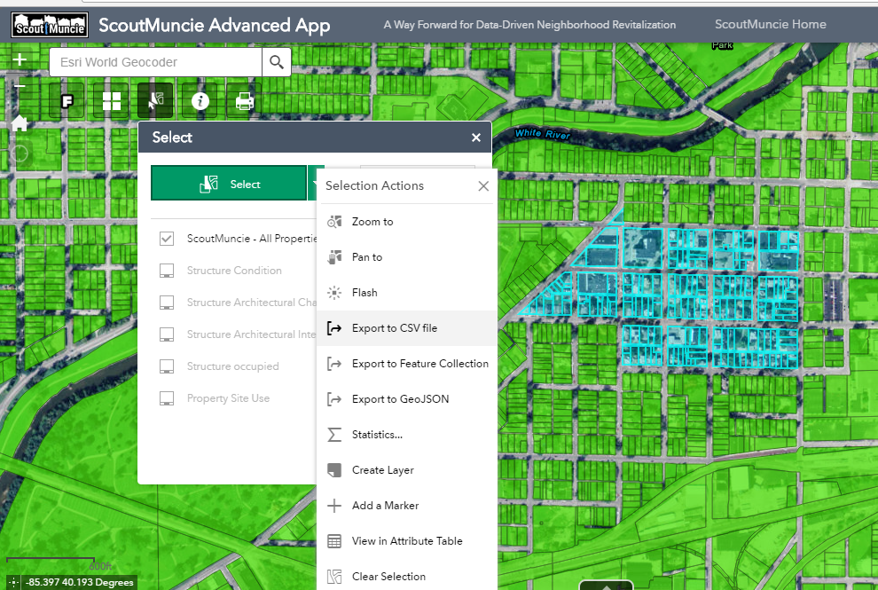
www.scoutmuncie.wordpress.com

Slide 37
Thank you!
bking@cityofmuncie.com
bri.paxton@gmail.com
Follow the Muncie Historic Preservation and Rehabilitation Commission on Facebook
Notes:
And Instagram?

